Slide 1
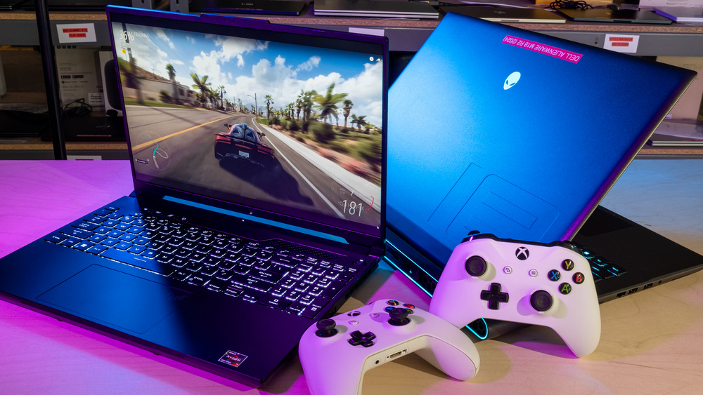
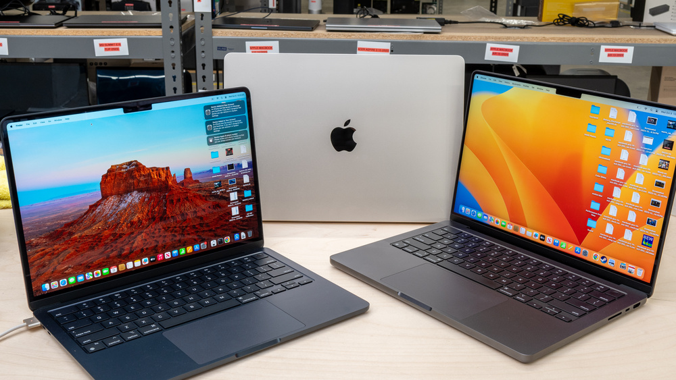
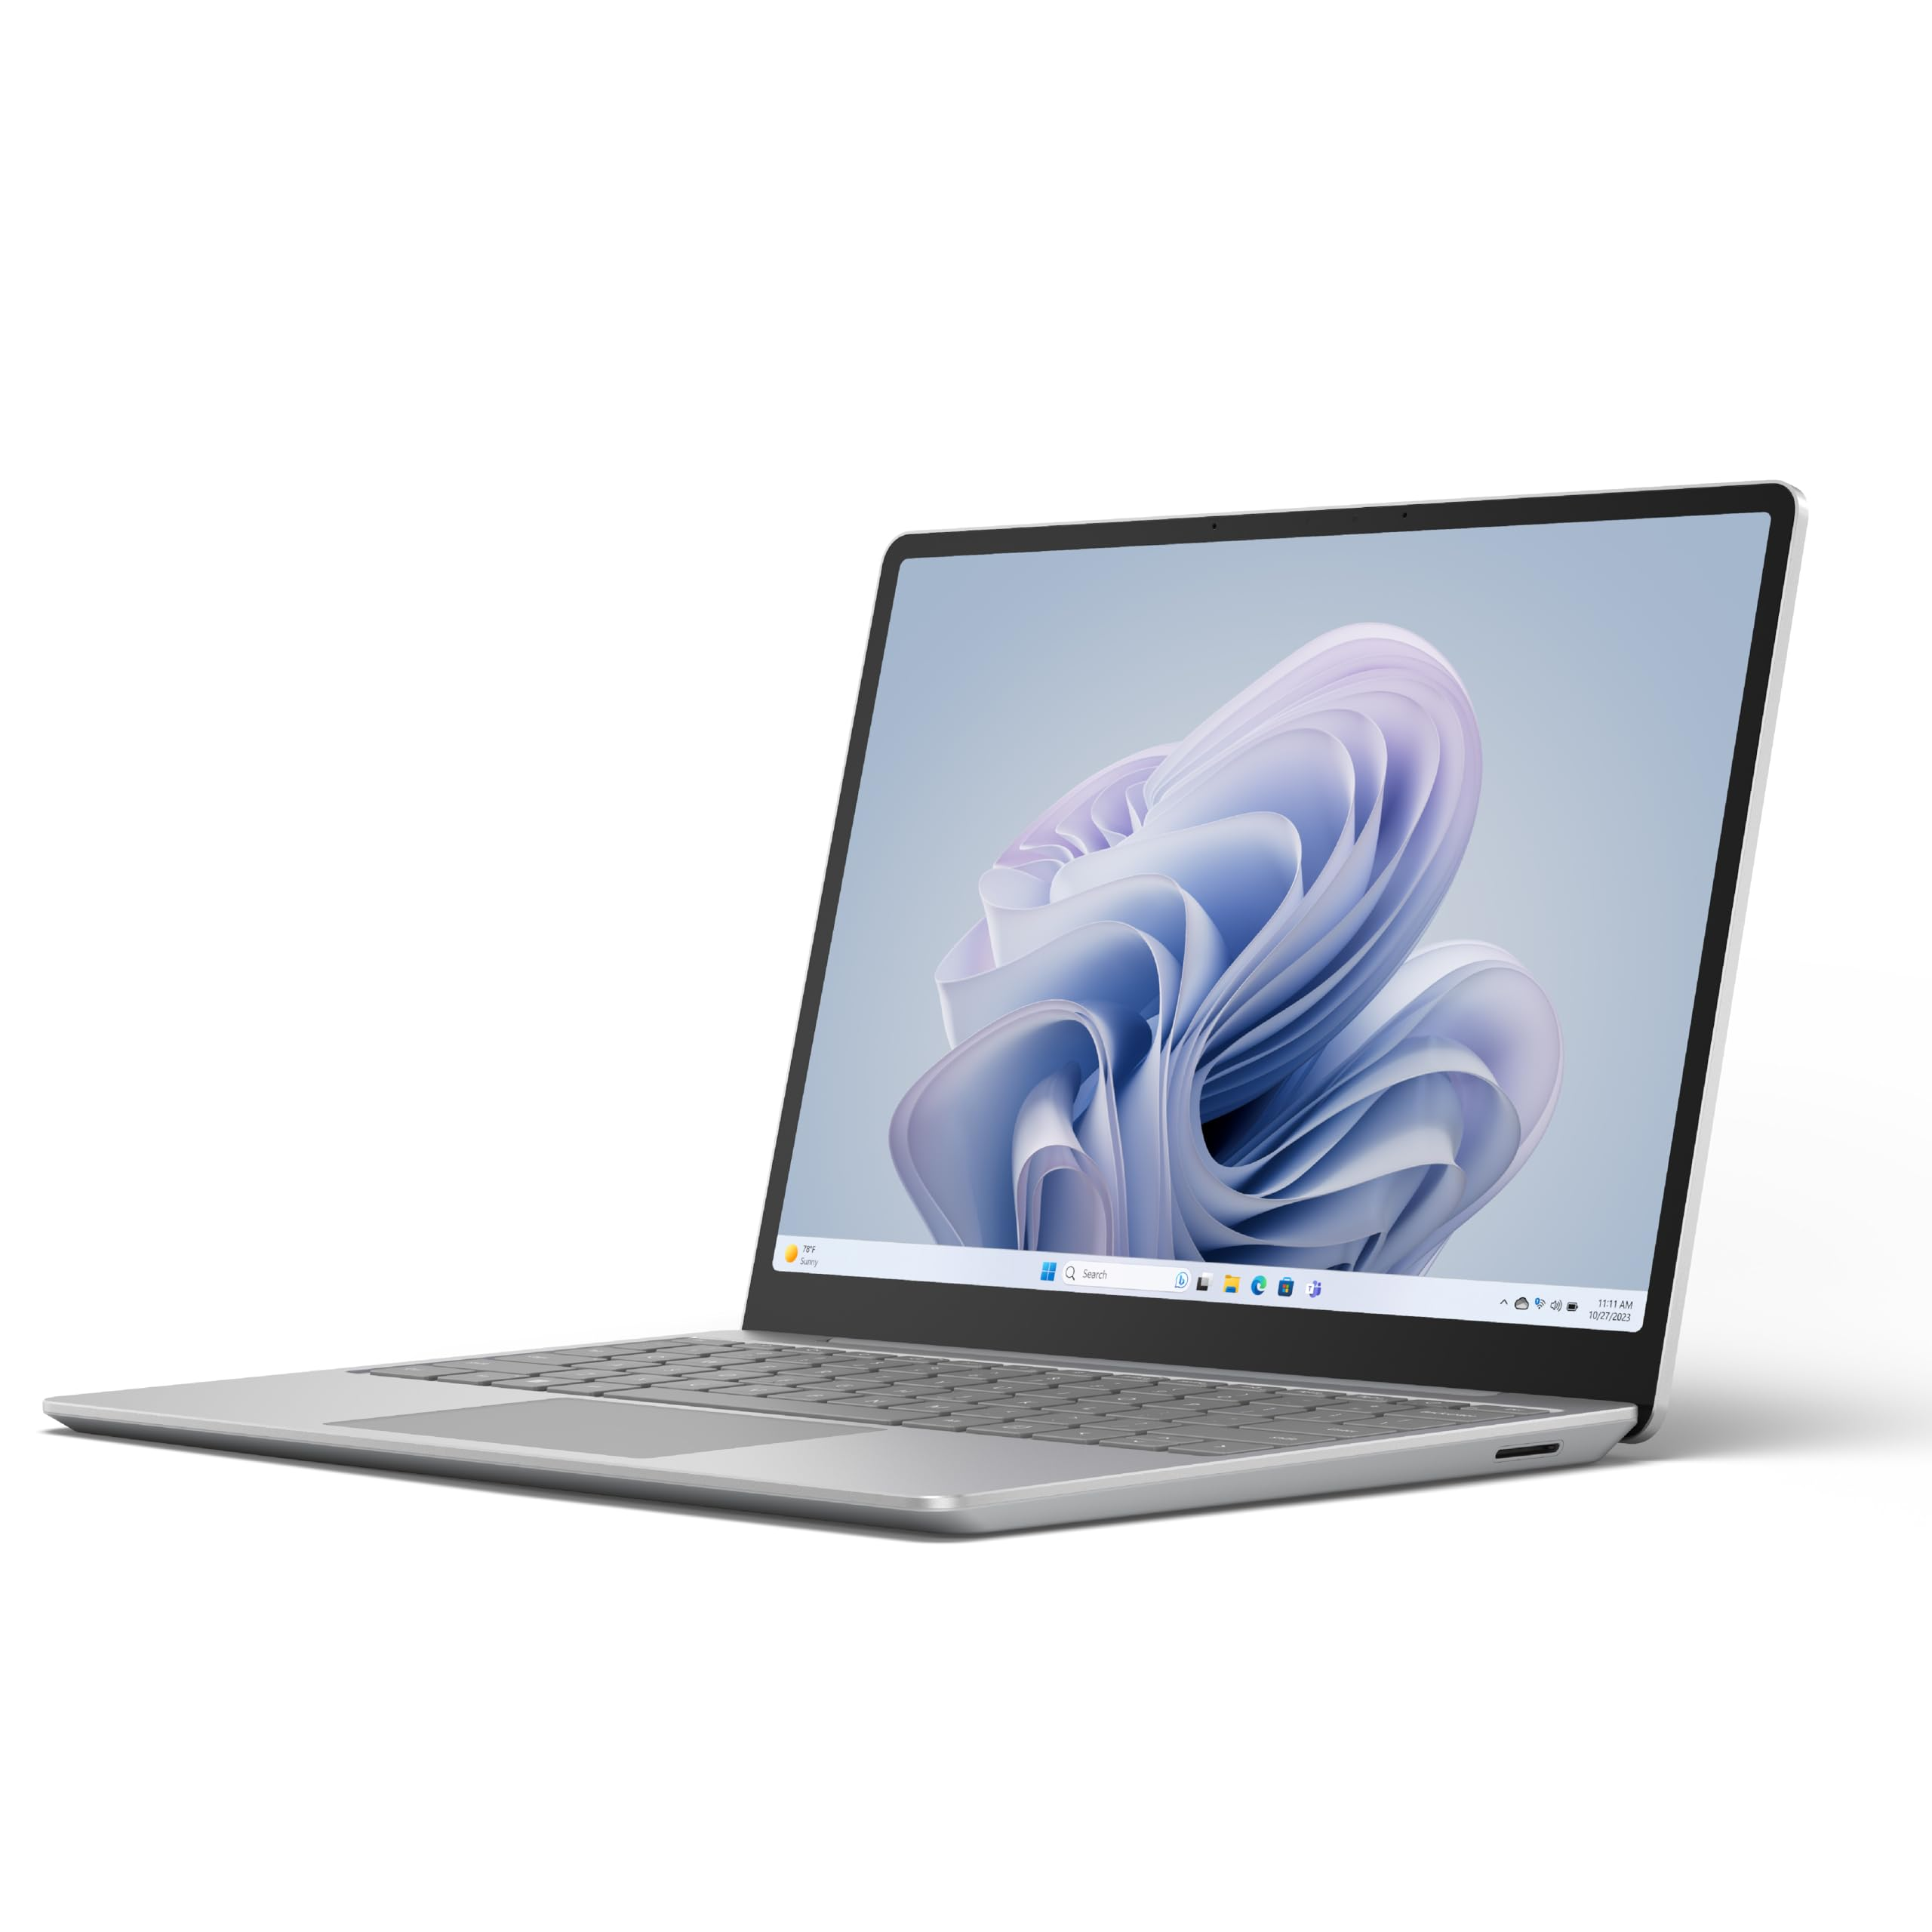
LAPTOP ANALYSIS
BY:
YASHWANTH K
NOV DA&DS 25
15/04/2025

Slide 2
PROJECT DESCRIPTION
Analyzed a laptop dataset to explore the relationship between specifications and pricing. Performed data cleaning, EDA, and visualization to uncover trends, customer preferences, and key factors influencing laptop prices. Provided actionable insights and recommendations for consumers and manufacturers.

Slide 3
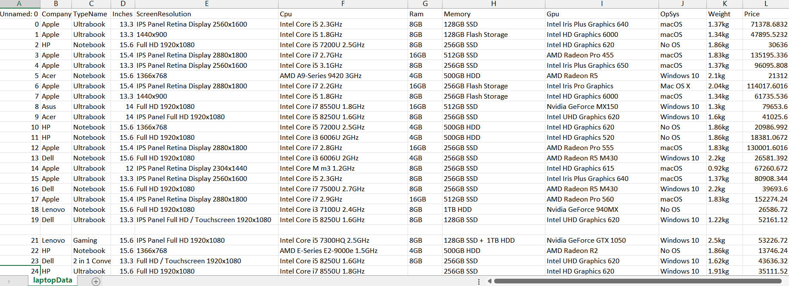
Before Cleaning the laptop Dataset
The cleaned dataset has 1303 entries and 12 columns.

Slide 4
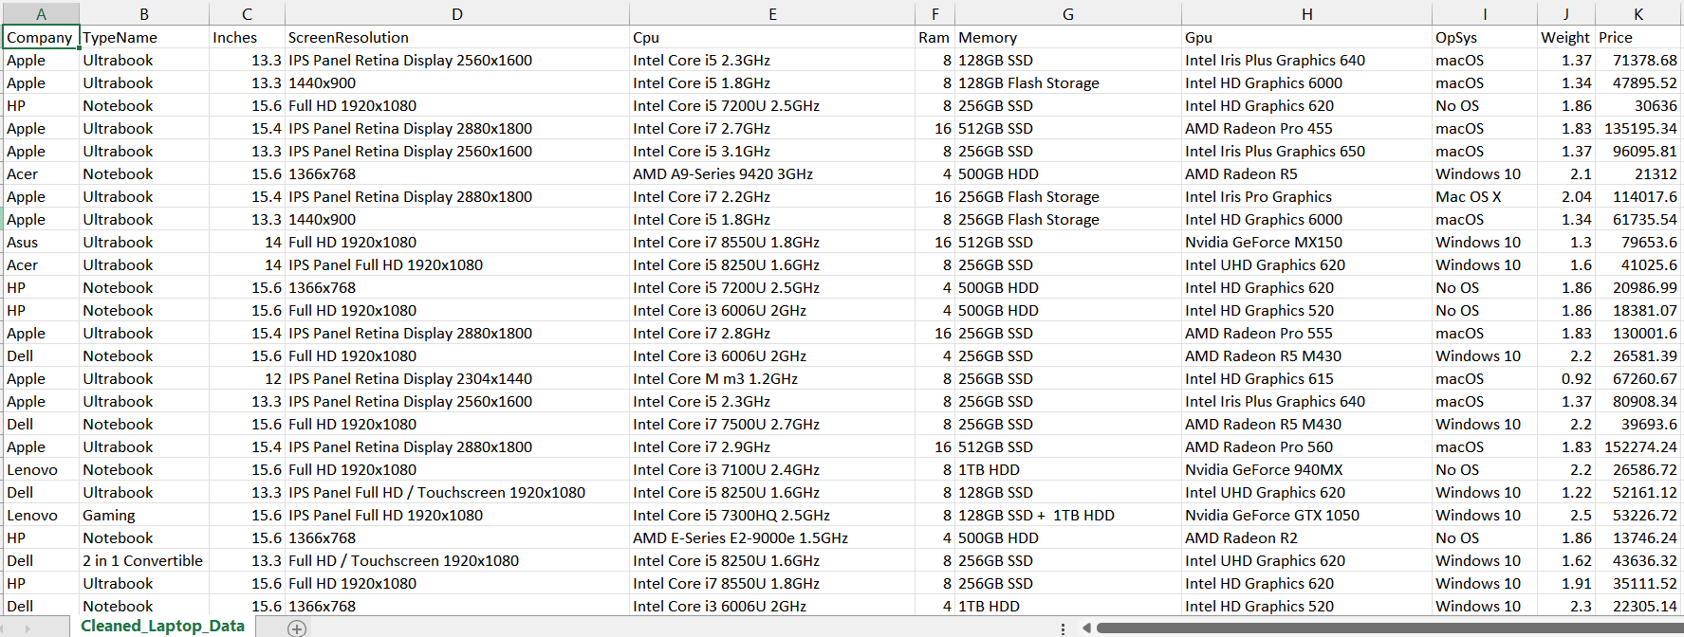
After Cleaning the laptop Dataset
The cleaned dataset has 1,245 entries and 11 columns.

Slide 5
Cleaned Dataset Overview
The cleaned dataset has 1,245 entries and 11 columns. Here's a summary of the dataset and a preview of the first few rows:
Laptop brand: (e.g., Apple, HP, Dell)
TypeName: Category of the laptop (e.g., Ultrabook, Notebook)
Inches: Screen size in inches
Screen Resolution: Screen resolution details
Cpu: CPU model
Ram: RAM size in GB (converted to integer)
Memory: Storage configuration (e.g., "256GB SSD", "1TB HDD")
Gpu: GPU model
OpSys: Operating system (e.g., Windows, macOS, Linux)
Weight: Weight in kilograms (converted to float)
Price: Price in local currency (float)

Slide 6
Insights
RAM, Screen Size, and Brand are the strongest predictors of price.
Dell, Lenovo, HP cover the widest range of user needs from budget to premium.
Ultrabooks and Notebooks dominate the market, with gaming laptops forming a specialized segment.
Lightweight laptops are generally preferred, but performance (RAM, GPU) overrides weight in some cases.
MacBooks hold premium space but limited to one type and OS, showing the power of brand loyalty and ecosystem.

Slide 7
Recommendations
1. Focus on budget-friendly laptops for customers in the lower price range (e.g., under 40K).
2. Segment laptops by price tiers (budget, mid-range, premium) to better target user needs.
3. Recommend higher RAM and SSD laptops for performance-focused users.
4. Suggest 4–8GB RAM laptops for casual users and 16GB+ for power users.
5. Offer alternative brands with similar specs and lower prices for cost-conscious buyers.
6. Highlight brand strengths (e.g., Apple for premium, Dell for business).
7. Identify best price-to-performance laptops using key specs like CPU, RAM, and storage.
8. Recommend laptops with high value in each price-performance category.

Slide 8
Recommendations
9. Guide OS-based recommendations (Windows for general use, macOS for creative work).
10. Suggest top-value laptops by cluster (e.g., gaming, business, student use).
11. Target marketing based on spec clusters identified via clustering analysis.
12. Promote older models at discounts when newer versions are released.
13. Use release dates to time promotions around product life cycles.
14. Match laptops to user use cases (e.g., gaming, browsing, office work).
15. Recommend customizable laptops for users needing flexibility in upgrades.

Slide 9


